Slide 1
The methodology of NEAR Project
New models of care within the framework of social services
FNAS Team
Fondazione Nazionale Assistenti Sociali, Italy
briante@fondazioneassistentisociali.it,
31 MAY 2023 | Pamplona

Slide 2
What? Objective of NEAR
To advance and consolidate new models of care in the field of social services.
This change of model must be accompanied by a change in professional praxis, moving from an expert role to one of accompaniment, support, guidance and motivation
The specific objectives of the project are:
▪ Identify care approaches and professional tools that facilitate this change.
▪ Identify and transfer good training practices aimed at professionals of the Social Services System for the new praxis.
Analysis by a regional diagnosis of the change of care model towards person-centered approaches to care
Identify the characteristics of the implemented approaches/models

Slide 3
Knowledge transfer as main focus of NEAR → at a REGIONAL LEVEL
REGIONAL DIAGNOSIS conducted by partners together with local groups of stakeholders, to evaluate the state of the art of their social service systems towards a model change.
They will identify:
examples of good practices,
skills that professionals need to improve or acquire,
examples of successful training experiences (such a Dialogic Approach).

Slide 4
Knowledge transfer as main focus of NEAR → at INTERREGIONAL LEVEL
Consortium Meetings: partners will share the knowledge coming from their regions by presenting their regional diagnosis report and good practices
Learning events: hosting partners will organize 5 learning events addressing a specif topic and bringing real experiences and expert lecturers.
Study visits: hosting partners will show visiting partners and stakeholders their social services functionning, explaining weaknesses and strengths and exchanging with local professionals
Peer review workshops: at the end of the study visits, partners and stakeholders will discuss the learning and provide critical opinions. Host partners will be in charge of producing the peer review reports, that will serve to transfer the knowledge to the stakeholder groups in each region.

Slide 5
Knowledge transfer as main focus of NEAR → at INTERREGIONAL LEVEL
Staff exchange: 4 staff exchanges will take place. The study visits will serve for partners to decide on which of the regions is selected for an exchange, which will count on the participation of partners' staff and stakeholders' staff. An exchange program will be defined including destination, length, participants and specific topic for the exchange.
Pilot actions: With the experience gained, partners aim at piloting the real application of the tools learned, or training processes for the acquisition of key competencies for a professional performance from the perspective of the Person-Centred Integrated Care Model. The design of these pilots will be done at the interregional level, with the support of all partners, whereas the implementation is aimed at the regional level, with the group of stakeholders, in order to ease the way towards a regional policy change. Pilots will be evaluated, and the conclusions will be extracted conducting towards raising recommendations for the improvement of the policy instruments addressed.

Slide 6
2. The concept of person-centred and community-based model: from top-down to bottom up approach
Characteristics of the integrated person-centred and community-based care model: focus on the person in need and his active participation through the family and the community
The key competencies (skills) that professionals need to improve or acquire to apply this new model of praxis.
Examples of successful training experiences (such as training in Dialogic Approach or other similar tools for professional practice).
Political and technical challenges

Slide 7
The effectiveness of interdisciplinarity as model of response to the needs and demands of citizens

Slide 8
Care models: toward an integrated approach
1. Person-centered comprehensive care model.
2. Relationship-centered care model (RCA)
3. Family-centered model of care.
4. Person-centered and community-based comprehensive care model: individuals, families and community for the care plan

Slide 9
Care models: towards an integrated approach between Spatial & Social dimension
Person-centered and community-based comprehensive care model: individuals, families and community for the care plan
The new model would be based on a structural integration between the Social Dimension and a Spatial Dimension, defined by the presence of territorial, geographical, environmental, architectural and urban aspects, which play a focal role in the construction of the new model.

Slide 10
3. Identification of Good Practices
One of the result indicators of NEAR is the delivery of 20 Good Practices (5 per region) on tools, skills and training to professionals for the acquisition of key competences to apply this new model of care See Template of Good Practice of traning and model change
good practice is defined as an initiative related to regional development policy which has proved to be successful in a region and which is of potential interest to other regions
Proved successful’ is when the good practice has already provided tangible and measurable results in achieving a specific objective.
The role of unsuccessful practices (political learning) and the level of exportability
Notes:
considering that a good practice becomes useful elsewhere only if it can be exported (perhaps among the major challenges of that good practice, there are aspects peculiar to that specific place that may not recur elsewhere or vice versa).

Slide 11
CHALLENGES FOR EXPORTABILITY of the Good Practices
1. Sharing & Acceptance: willingness to apply the good practice in one's own context.
2. Legislation: Possible necessary legislation adjustments.
3. Policy: Verification of compatibility with the policies of your context (regardless of the quality of the good practice).
4. Specific Skills: the good practice implies methods of action that are not easily applied to the local/cultural context in which it would be exported, defining the risk of lack of specific skills.
5. Cultural dimension: Different cultural declination of the various social groups which, with the same general characteristics of belonging, develop in a manner and with very different characteristics according to the different social contexts of belonging.
6. Environmental Dimension: geographical spatial context different from one area to another which requires an effort to adapt certain tools to a different environmental geographical context
Notes:
be exported elsewhere.
Obviously, among the major challenges of that good practice, there are aspects peculiar to that specific place that may not recur elsewhere or vice versa.

Slide 12
4. The role of local stakeholder in NEAR
Who? Interested party as stakeholder group of organisations from each region with an interest in the policy issue addressed: important for policy development (Policy makers, Professionals, Beneficiaries of policy, third sector, NGO’s, the business community, employers, public service providers, trade unions, knowledge institutions, professional associations, potential funders)
How? By a participatory approach, a holistic approach and a bottom-up approach

Slide 13
?
Time for questions

Slide 14
Thank you!
www.interregeurope.eu/NEAR

Slide 15
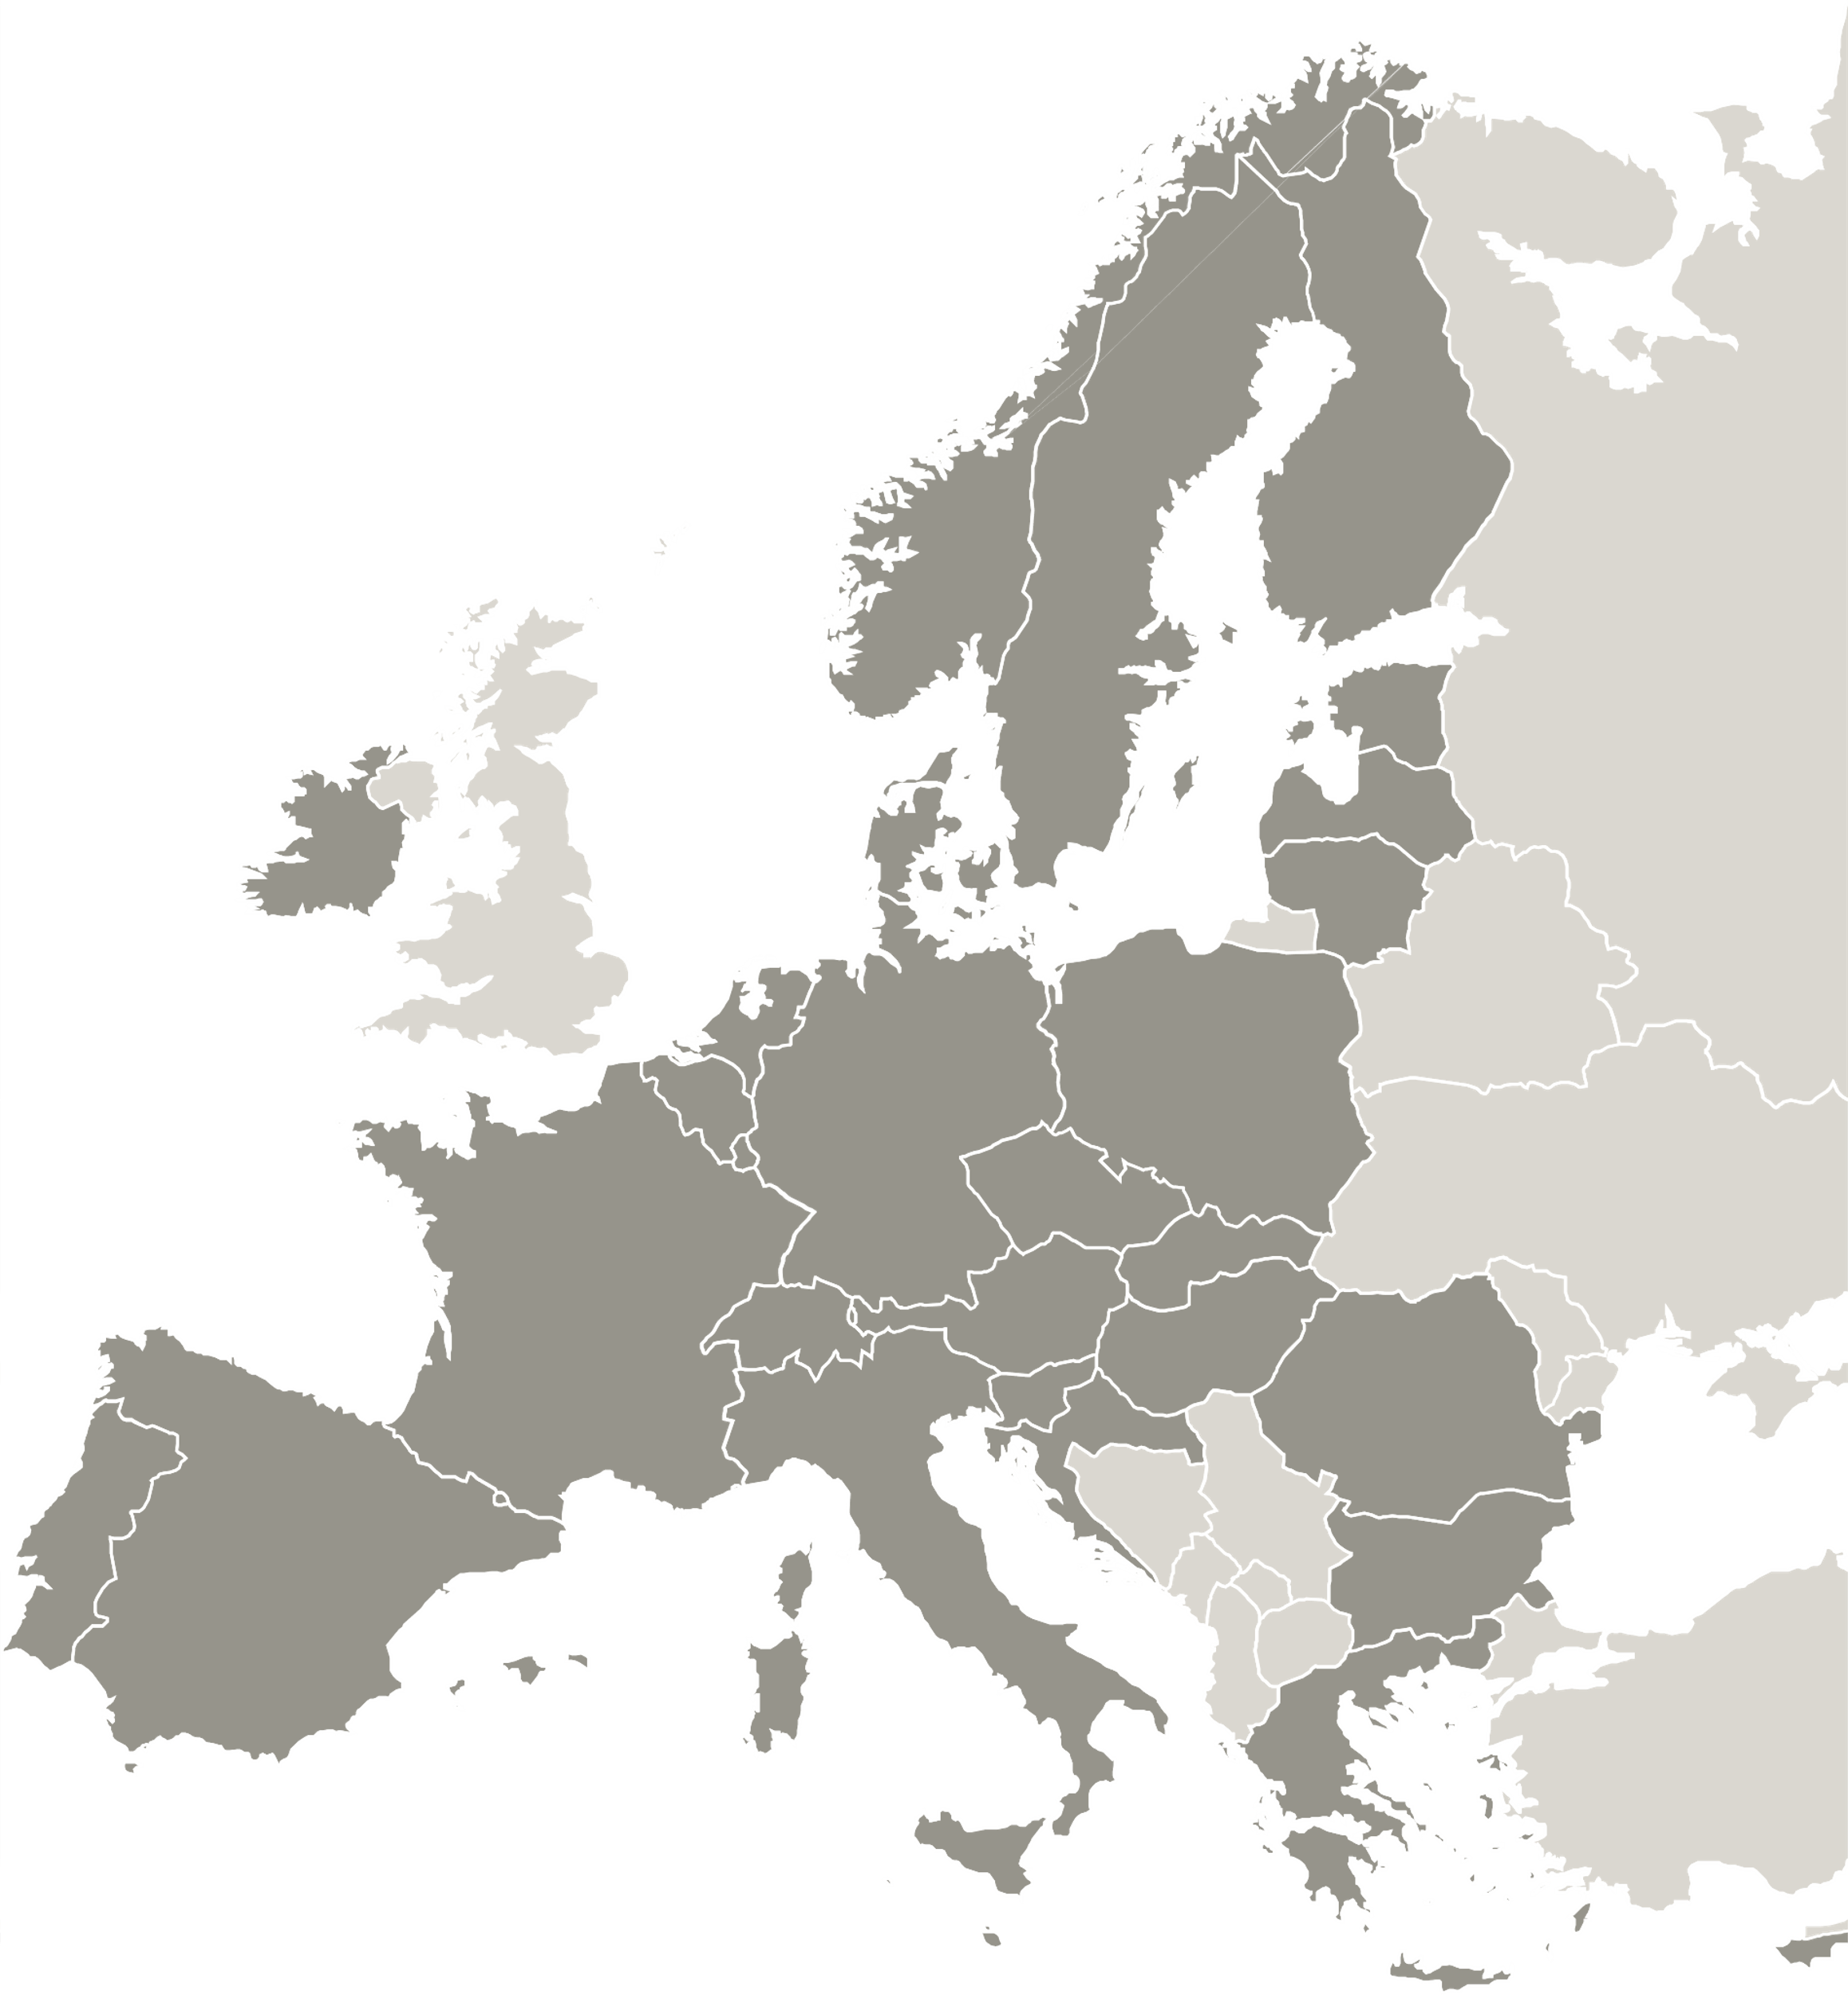
The project NEAR is implemented in the framework of the Interreg Europe programme and co-financed by the European Union.
www.interregeurope.eu

